Slide 1
Learn Factory integration Paper: From Rule-Based PLC Monitoring to Real-Time Anomaly Detection: A Machine Learning Framework for Hydraulic Systems Using Probabilistic and Deep Learning Models

Slide 2
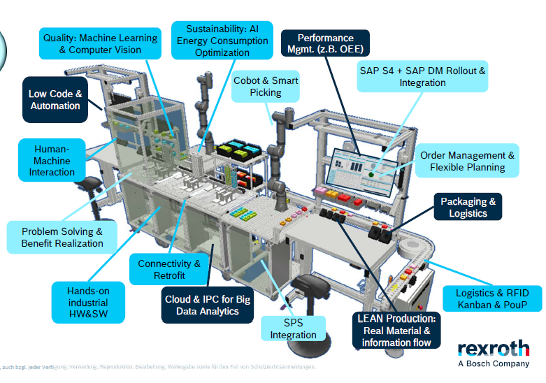
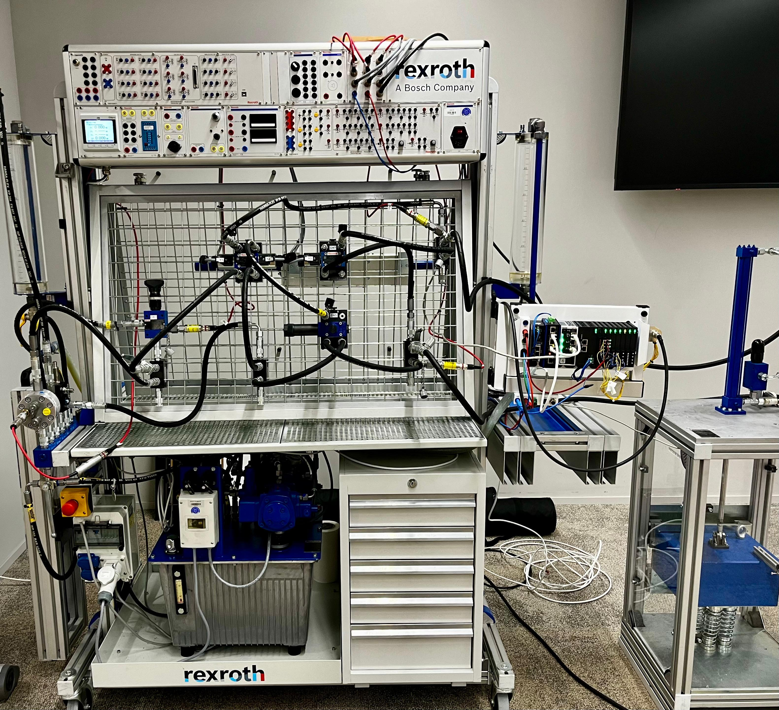
Target: Enable the Automax 105# to have the same analysis and monitoring capabilities as the Learn Factory.
Integration
No data storage
No historical analysis
Monitoring based on hard-coded PLC conditions

Slide 3
Unlocking the Potential of Intelligent Hydraulic Monitoring
We are developing an AI-driven monitoring system that leverages historical operability data to enhance hydraulic system performance. While engineers traditionally rely on PLC threshold alerts, empowering them to interpret data and refine models opens new avenues for efficiency and predictive maintenance.
This initiative is just the beginning. Our first success in monitoring a specific hydraulic setup lays the foundation for a scalable, industry-agnostic solution. The vision: a generalized intelligent system adaptable to any client and any hydraulic configuration, unlocking broader industrial applications and a new standard in operational intelligence.
Second paper/Thesis:
“Adaptive AI framework for Predictive Maintenance Across Varied Hydraulic Systems”

Slide 4
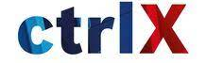


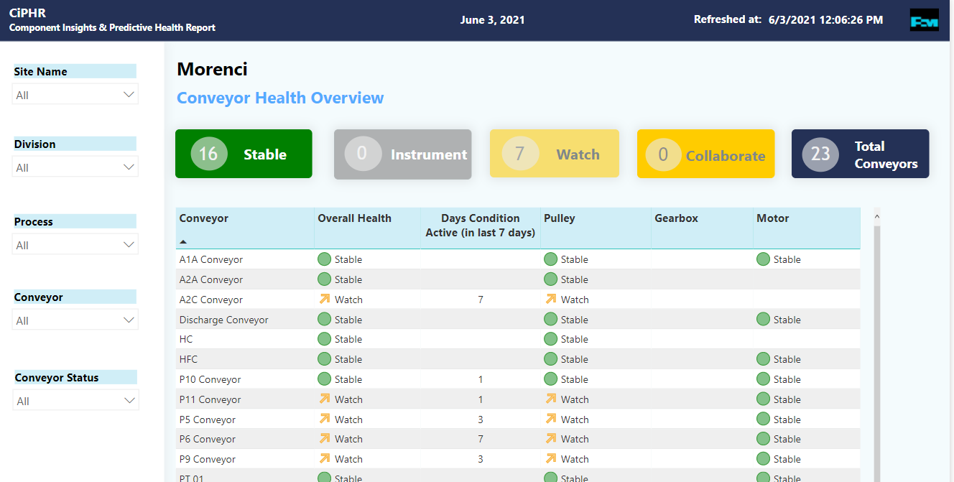


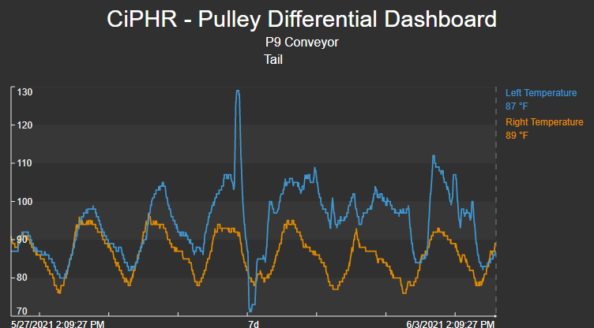



Architecture HYDRA – Hydraulic Data-driven Reliability & Analysis
Data Sourcing
Core Logic (IPC)
Presentation / Delivery
(1 table)
Equipment_List
Definitions and Settings
Power BI for daily, monlthly, yearly analysis
Supervision by a specialist
Retrain
Data_ctrlX
Grafana – for Realtime visualization
Streaming Analysis
HYDRA Alerting Logic
Does current values look different from the baseline? (symptoms)
How similar is this pattern to a historical occurrence? (overall risk)
HYDRA Baseline Logic
Use last … 3 months to establish a normal behavior
Review the normal behavior every 3 months
(1 table)
Models
Snowflake
(interpolated data)
Hydra_table
Warehouse Database
LSTM Autoencoder, Isolation Forest, Hidden Markov Models , Bayesian Networks
S$−10$
HYDRA States & Outputs
(# tables)
$$S$$
Job triggered for event every 10 seconds – Real time monitoring

Slide 5
ETL – Extract transform load from CtrlX Status: Minimum Viable Product (MVP) – dockers and development Finished Implementing project in CtrlX connected with sensors In progress

Slide 6
Architecture ETL
Extraction
Transformation
Load
Docker Dagster
Orchestrator
Docker Transform
Docker Load
Docker Extract
Re connection Extract
No
Extract
Are there
messages
From the
broker?
Load
Transform
Yes
Docker Solace
SOLACE BROKER
Docker DB
Postgres Data base
baseline and it has expired. All baseline values are accumulated and one-time put function writes it to SF Tables.

Slide 7
Thank you!

